Slide 1
Computer Architecture Experiment
Topic 5. Dynamically Scheduled Pipelines using Scoreboarding
浙江大学计算机学院
2024年11月

Slide 2
Outline
Experiment Purpose
Experiment Task
Basic Principle
Operating Procedures
Checkpoints

Slide 3
Experiment Purpose
Understand the principle of piplines that support multicycle operations.
Master the design methods of piplines that support multicycle operations.
Master verification methods of pipelined CPU supporting multicycle operations.

Slide 4
Experiment Task
Redesign the pipelines with IF/ID/FU/WB stages and FU stage supporting multicycle operations.
Redesign of CPU Controller.
Verify the Pipelined CPU with program and observe the execution of program.

Slide 6
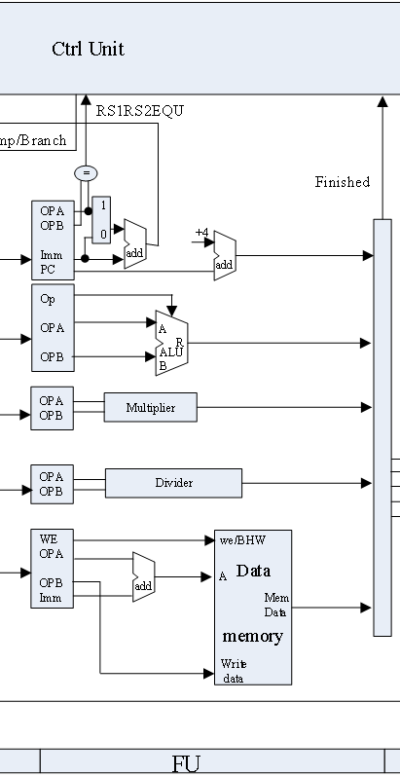
Architecture Overview – FU
// FU
FU_ALU alu(...);
FU_mem mem(...);
FU_mul mu(...);
FU_div du(...);
FU_jump ju(...);

Slide 7
Control Unit
// IF
output reg_IF_en, branch_ctrl,
// ID
output reg_ID_en, reg_ID_flush,
output[2:0] ImmSel,
output ALU_en, MEM_en, MUL_en, DIV_en, JUMP_en,
// FU
output[3:0] JUMP_op,
output[3:0] ALU_op,
output ALUSrcA,
output ALUSrcB,
output MEM_we,
// WB
output reg[2:0] write_sel,
output reg[4:0] rd_ctrl,
output reg reg_write
);
module CtrlUnit(
input clk,
input rst,
input[31:0] inst,
input valid_ID,
input ALU_done,
input MEM_done,
input MUL_done,
input DIV_done,
input JUMP_done,
input cmp_res_FU,

Slide 8
Function Unit – ALU
module FU_ALU(
input clk, EN,
input[3:0] ALUControl,
input[31:0] ALUA, ALUB,
output[31:0] res,
output zero, overflow,
output finish
);
reg state;
assign finish = state == 1'b1;
initial begin
state = 0;
end
reg[3:0] Control;
reg[31:0] A, B;
always@(posedge clk) begin
if(EN & ~state) begin // state == 0
A <= ...;
B <= ...;
Control <= ...;
state <= 1;
end
else state <= 0;
end

Slide 9
Function Unit – MUL
always@(posedge clk) begin
if(EN & ~|state) begin
A_reg ...
B_reg ...
state ...
end
else state <= {1'b0, state[6:1]};
end
wire[63:0] mulres;
multiplier mul(.CLK(clk),.A(A_reg),.B(B_reg),.P(mulres));
assign res = mulres[31:0];
endmodule
module FU_mul(
input clk, EN,
input[31:0] A, B,
output[31:0] res,
output finish
);
reg[6:0] state;
assign finish = state[0] == 1'b1;
initial begin
state = 0;
end
reg[31:0] A_reg, B_reg;

Slide 10
Function Unit – DIV
always@(posedge clk) begin
if(EN & ~state) begin // state == 0
A_reg ...
B_reg ...
A_valid ...
B_valid ...
state ...
end
else if(res_valid) begin
A_valid ...
B_valid ...
state ...
end
end
divider div(.aclk(clk),
.s_axis_dividend_tvalid(A_valid),
.s_axis_dividend_tdata(A_reg),
.s_axis_divisor_tvalid(B_valid),
.s_axis_divisor_tdata(B_reg),
.m_axis_dout_tvalid(res_valid),
.m_axis_dout_tdata(divres)
);
assign res = divres[63:32];
endmodule
module FU_div(
input clk, EN,
input[31:0] A, B,
output[31:0] res,
output finish
);
wire res_valid;
wire[63:0] divres;
reg state;
assign finish = res_valid & state;
initial begin
state = 0;
end
reg A_valid, B_valid;
reg[31:0] A_reg, B_reg;

Slide 11
Function Unit – JUMP
always@(posedge clk) begin
if(EN & ~state) begin // state == 0
JALR_reg ...
cmp_ctrl_reg ...
rs1_data_reg ...
rs2_data_reg ...
imm_reg ...
PC_reg ...
state ...
end
else state ...
end
cmp_32 cmp ...
add_32 a...
add_32 b...
endmodule
module FU_jump(
input clk, EN, JALR,
input[2:0] cmp_ctrl,
input[31:0] rs1_data, rs2_data, imm, PC,
output[31:0] PC_jump, PC_wb,
output cmp_res, finish
);
reg state;
assign finish = state == 1'b1;
initial begin
state = 0;
end
reg JALR_reg;
reg[2:0] cmp_ctrl_reg;
reg[31:0] rs1_data_reg, rs2_data_reg, imm_reg, PC_reg;

Slide 12
Function Unit – MEM
always@(posedge clk) begin
if(EN & ~|state) begin
mem_w_reg ...
bhw_reg ...
rs1_data_reg ...
rs2_data_reg ...
imm_reg ...
state ...
end
else state ...
end
wire[31:0] addr;
add_32 add...
RAM_B ram(.clka(clk),.addra(addr),.dina(rs2_data_reg),.wea(mem_w_reg),
.douta(mem_data),.mem_u_b_h_w(bhw_reg));
endmodule
module FU_mem(
input clk, EN, mem_w,
input[2:0] bhw,
input[31:0] rs1_data, rs2_data, imm,
output[31:0] mem_data,
output finish
);
reg[1:0] state;
assign finish = state[0] == 1'b1;
initial begin
state = 0;
end
reg mem_w_reg;
reg[2:0] bhw_reg;
reg[31:0] rs1_data_reg, rs2_data_reg, imm_reg;

Slide 13
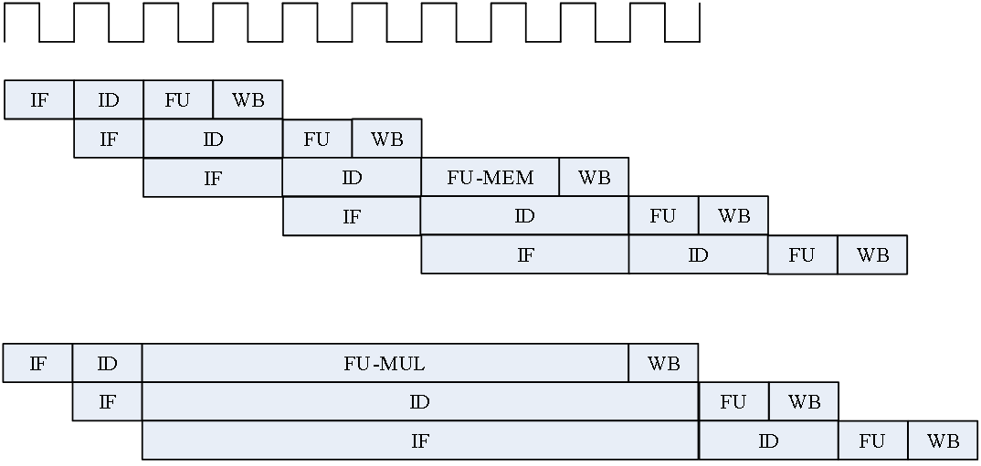
Pipelines resolving Data Hazards
Stall the pipeline to deal with data hazard!

Slide 14
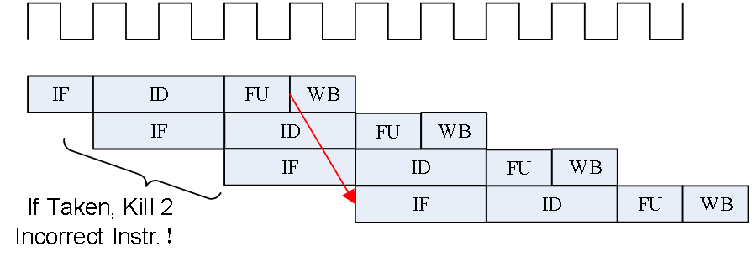
Pipelines resolving Control Hazards
Predict-not-taken
Condition and Addr. Calculation in FU

Slide 15
Instr. Mem.(1)
NO. | Instruction | Addr. | Label | ASM | Comment
0 | 00000013 | 0 | __start: | addi x0, x0, 0
1 | 00402103 | 4 |  | lw x2, 4(x0)
2 | 00802203 | 8 |  | lw x4, 8(x0)
3 | 004100b3 | C |  | add x1, x2, x4
4 | fff08193 | 10 |  | addi x3, x1, -1
5 | 00c02283 | 14 |  | lw x5, 12(x0)
6 | 01002303 | 18 |  | lw x6, 16(x0)
7 | 01402383 | 1C |  | lw x7, 20(x0)
8 | 40220433 | 20 |  | sub x8,x4,x2
9 | ffd50493 | 24 |  | addi x9,x10,-3
10 | 00520c63 | 28 |  | beq x4,x5,label0
11 | 00420a63 | 2C |  | beq x4,x4,label0
12 | 03000a13 | 30 |  | addi x20,x0,48
13 | 03400a13 | 34 |  | addi x20,x0,52
14 | 03800a13 | 38 |  | addi x20,x0,56

Slide 16
Instr. Mem.(2)
NO. | Instruction | Addr. | Label | ASM | Comment
15 | 03c00a13 | 3C |  | addi x20,x0,60
16 | 00004537 | 40 | label0: | lui x10,4
17 | 014005ef | 44 |  | jal x11,20
18 | 04800a13 | 48 |  | addi x20,x0,72
19 | 04c00a13 | 4C |  | addi x20,x0,76
20 | 05000a13 | 50 |  | addi x20,x0,80
21 | 05400a13 | 54 |  | addi x20,x0,84
22 | ffff0617 | 58 |  | auipc x12, 0xffff0
23 | 0223c6b3 | 5C |  | div x13, x7, x2
24 | 02520733 | 60 |  | mul x14, x4, x5
25 | 022687b3 | 64 |  | mul x15, x13, x2
26 | 00400813 | 68 |  | addi x16, x0, 4
27 | 000008e7 | 6C |  | jalr x17,0(x0)

Slide 17
Data Mem.
NO. | Data | Addr. | Comment
0 | 000080BF | 0
1 | 00000008 | 4
2 | 00000010 | 8
3 | 00000014 | C
4 | FFFF0000 | 10
5 | 0FFF0000 | 14
6 | FF000F0F | 18
7 | F0F0F0F0 | 1C
8 | 00000000 | 20
9 | 00000000 | 24
10 | 00000000 | 28
11 | 00000000 | 2C
12 | 00000000 | 30
13 | 00000000 | 34
14 | 00000000 | 38
15 | 00000000 | 3C
NO. | Instruction | Addr. | Comment
16 | 00000000 | 40
17 | 00000000 | 44
18 | 00000000 | 48
19 | 00000000 | 4C
20 | A3000000 | 50
21 | 27000000 | 54
22 | 79000000 | 58
23 | 15100000 | 5C
24 | 00000000 | 60
25 | 00000000 | 64
26 | 00000000 | 68
27 | 00000000 | 6C
28 | 00000000 | 70
29 | 00000000 | 74
30 | 00000000 | 78
31 | 00000000 | 7C

Slide 18
Test Bench
RV32core core(
.debug_en(1'b0),
.debug_step(1'b0),
.debug_addr(7'b0),
.debug_data(),
.clk(clk),
.rst(rst),
.interrupter(1'b0)
);
initial begin
clk = 0;
rst = 1;
#2 rst = 0;
end
always #1 clk = ~clk;

Slide 19
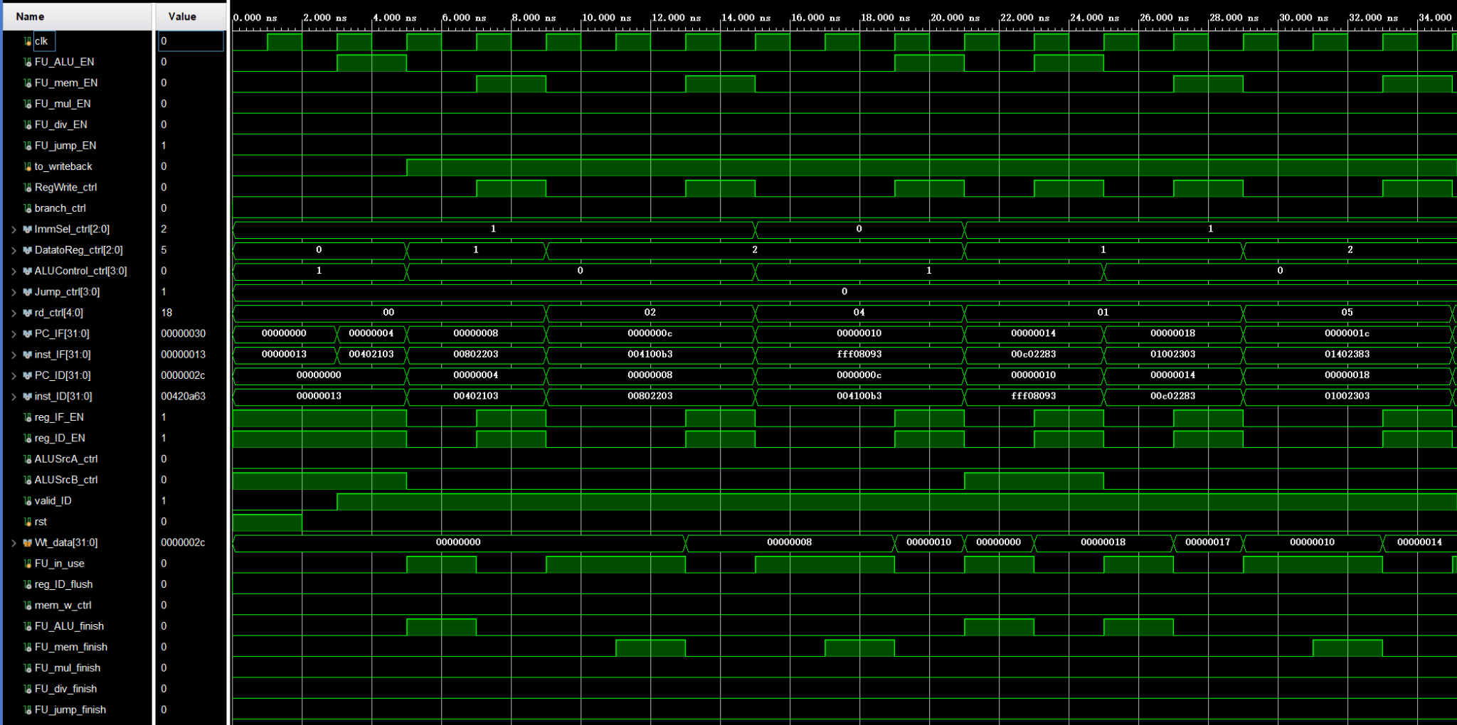
Simulation

Slide 20
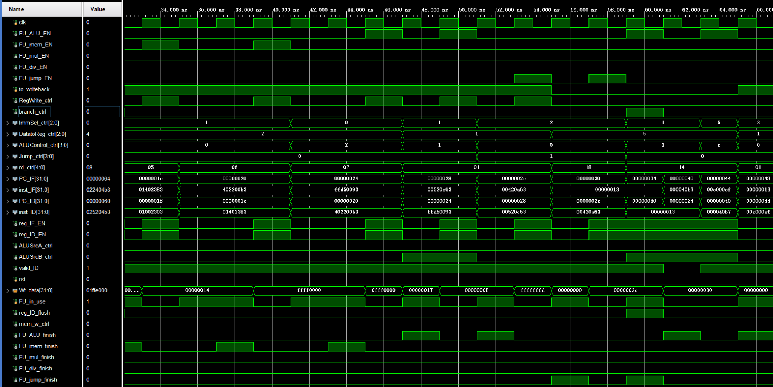
Simulation

Slide 21
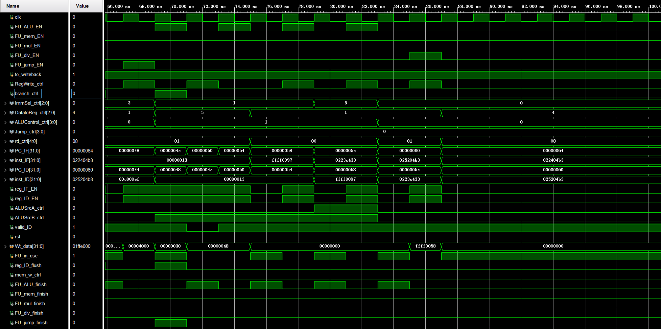
Simulation
IF
FU
ID

Slide 22
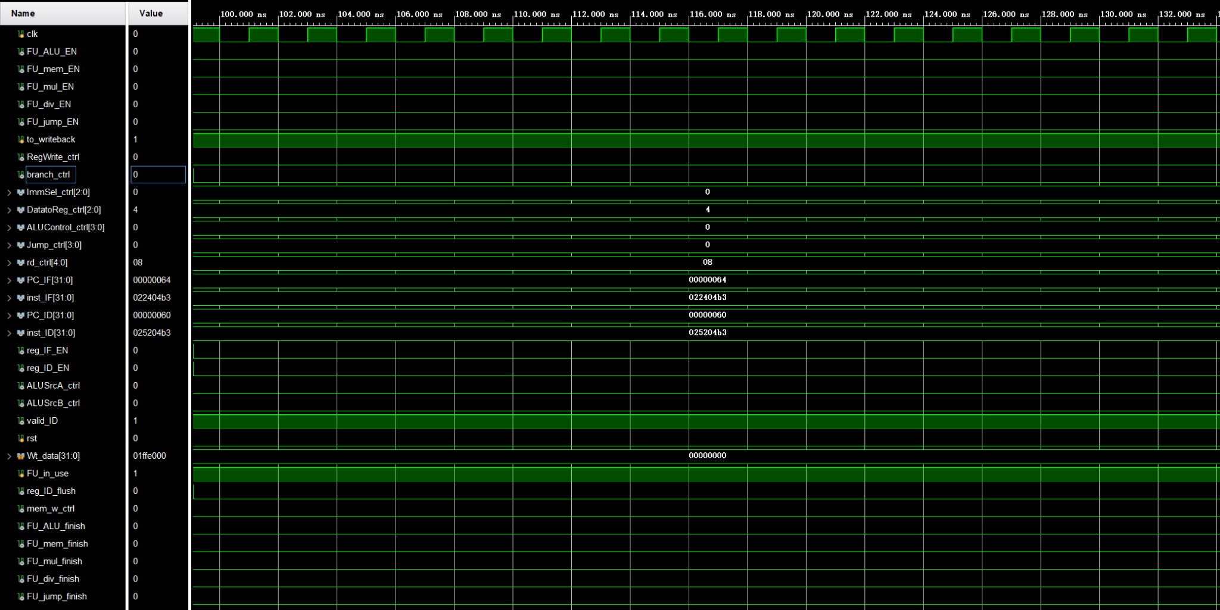
Simulation

Slide 23

Simulation
Next FU EN
WB

Slide 24
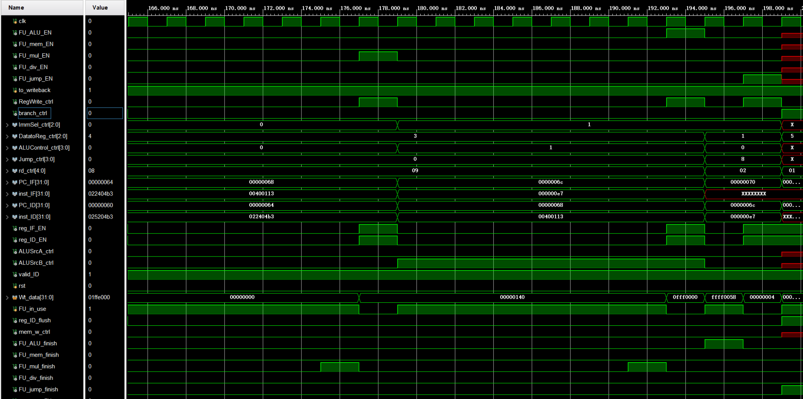
Simulation

Slide 25
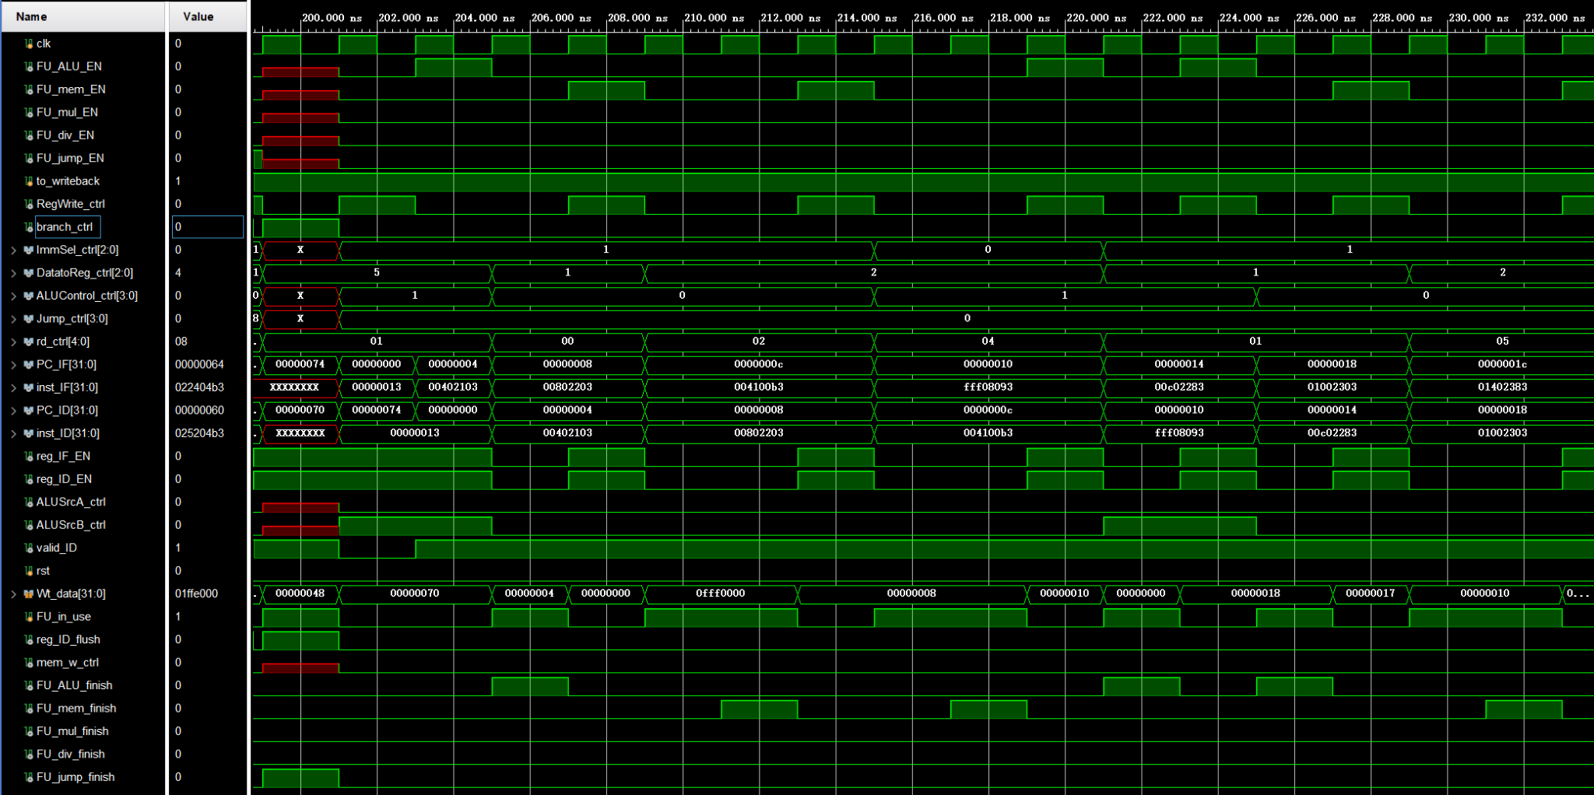
Simulation

Slide 26
Checkpoints
CP 1:
Waveform Simulation of the Pipelined CPU with the verification program
CP 2:
FPGA Implementation of the Pipelined CPU with the verification program

Slide 27
Thanks!

